Slide 1
Conceptual Keratoconus survey program
By Omar Villegas
Troy Adams
CIS129
8/4/2024

Slide 2
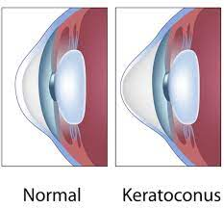
Why did I choose this topic?
I was diagnosed with a rare eye disease called Keratoconus five years ago, which is when the cornea becomes weak and cone shaped instead of its traditional dome shape. This results in distorted vision and is progressive with no known cure or true cause.
I used this opportunity to think of a hypothetical program that asks patients with Keratoconus specific questions then sends the results to a csv file in order to analyze and find a common link between each person.

Slide 3
History, research and future potential of the problem.
According to the National Keratoconus Foundation, the causes potentially could be excessive eye rubbing, allergies and damage to the cornea by free radicals.
They also did a study on adolescents ranging from 4 to 11 in public schools and found that in 2,007 students, six had Keratoconus, and three were suspected. This meant that 1 in 223 students had the disease, which shows that it is becoming less rare.
Currently, there aren’t any programs specifically designed for surveying Keratoconus patients, however there are surveys you can take for a myriad of different rare diseases.
It is important to find a solution because this disease, while rare, is debilitating for vision and as described above it starts in adolescence which could mean a life long battle with vision loss, surgery and rising costs.

Slide 4
Program approach and planning
My approach to the design would be based on web surveys that ask users certain questions related to their disease.
Variety of questions specific to Keratoconus patients such as: What kinds of medications did you have as a child? Family history? What is your average diet like?
It needs to contain input validation as users can input strings and integers.
It would need read and writing capabilities and the ability to store all of the data into a csv file which is helpful for separating strings and integers.
The user interface needs to be simple and easy to navigate through.

Slide 5
Pseudocode statements sample
Import csv
Open file for write mode
Begin input validation
Display “Has anyone in your family been diagnosed with Keratoconus?”
Prompt user to enter a string
While input is equal to string, continue
Store input in csv file
Display “What kinds of medications did you take as a child?”
Prompt user to enter a string
While input is equal to string, continue
Store input in csv file

Slide 6
Pseudocode statements continued
Display “At what age did you start noticing symptoms?”
Prompt user to enter integer
While input is equal to integer, continue
Store input in csv file
Display “Do you rub your eyes excessively?””
While input is equal to string, continue
Store input in csv file
Display “Thank you for your contribution and for taking this survey!”
Close file for writing

Slide 7

User interface design samples

Slide 8


Slide 9
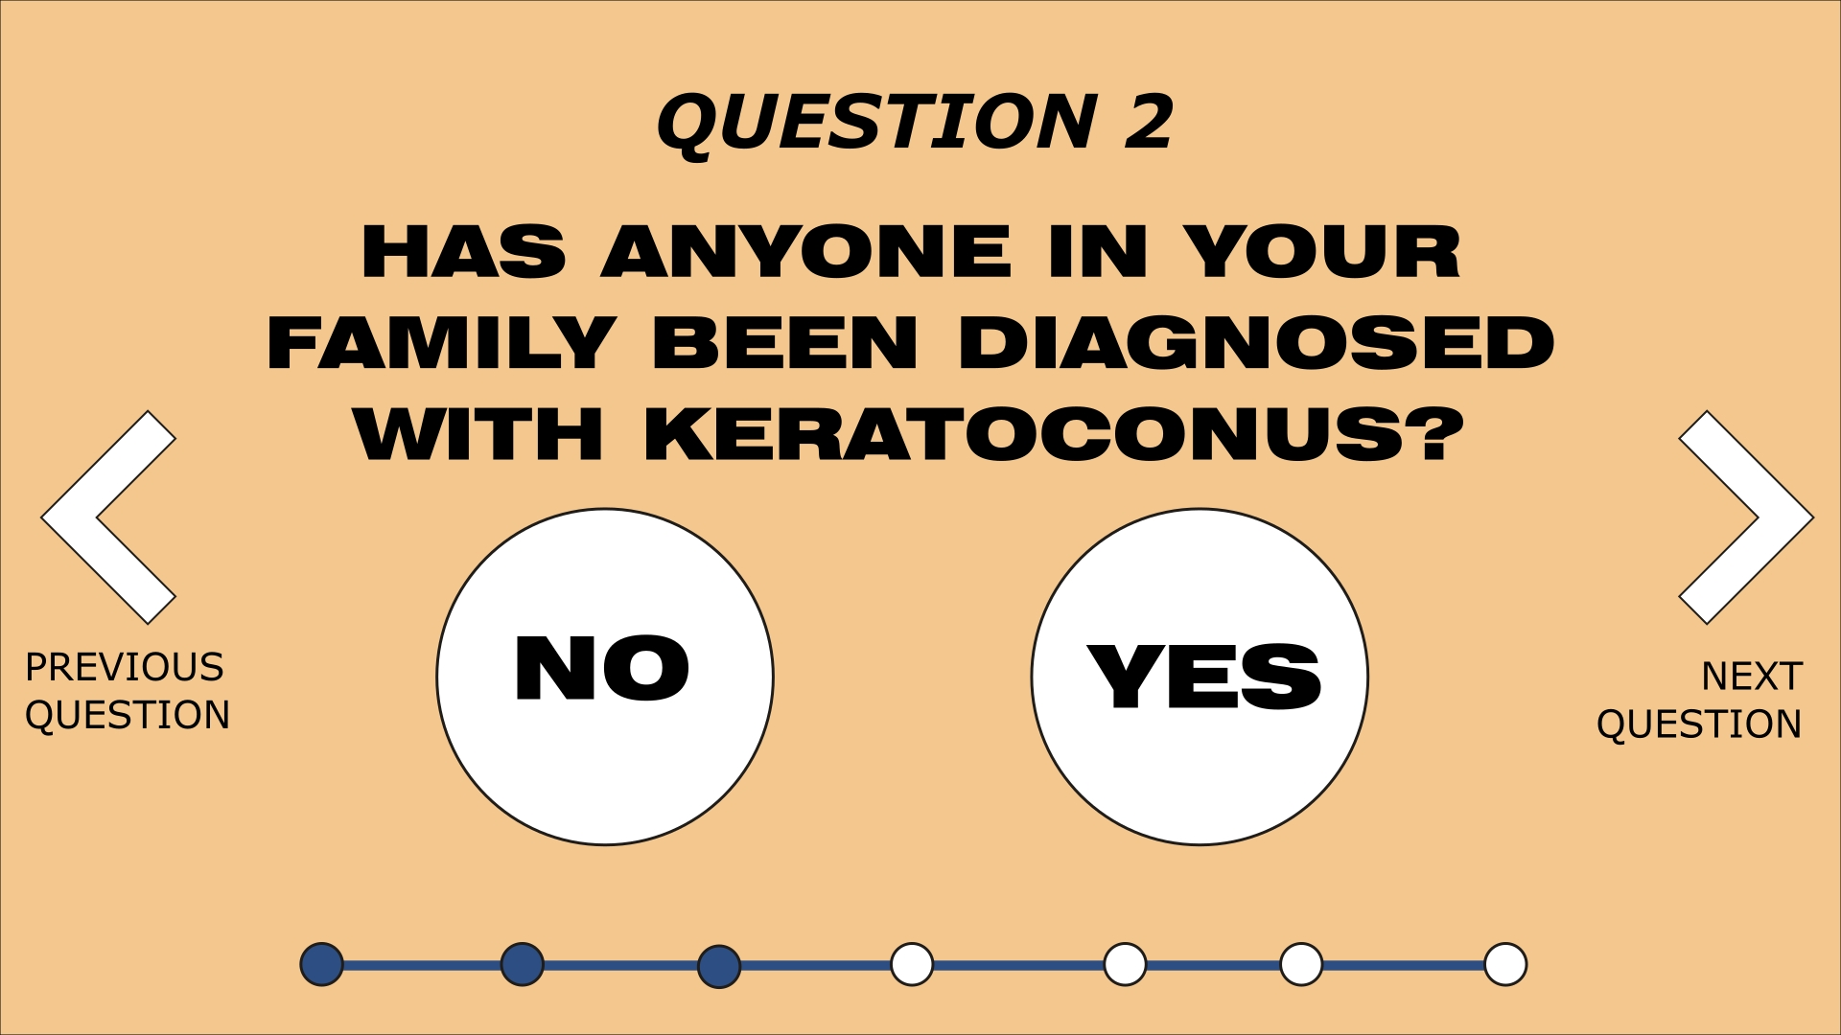

Slide 10
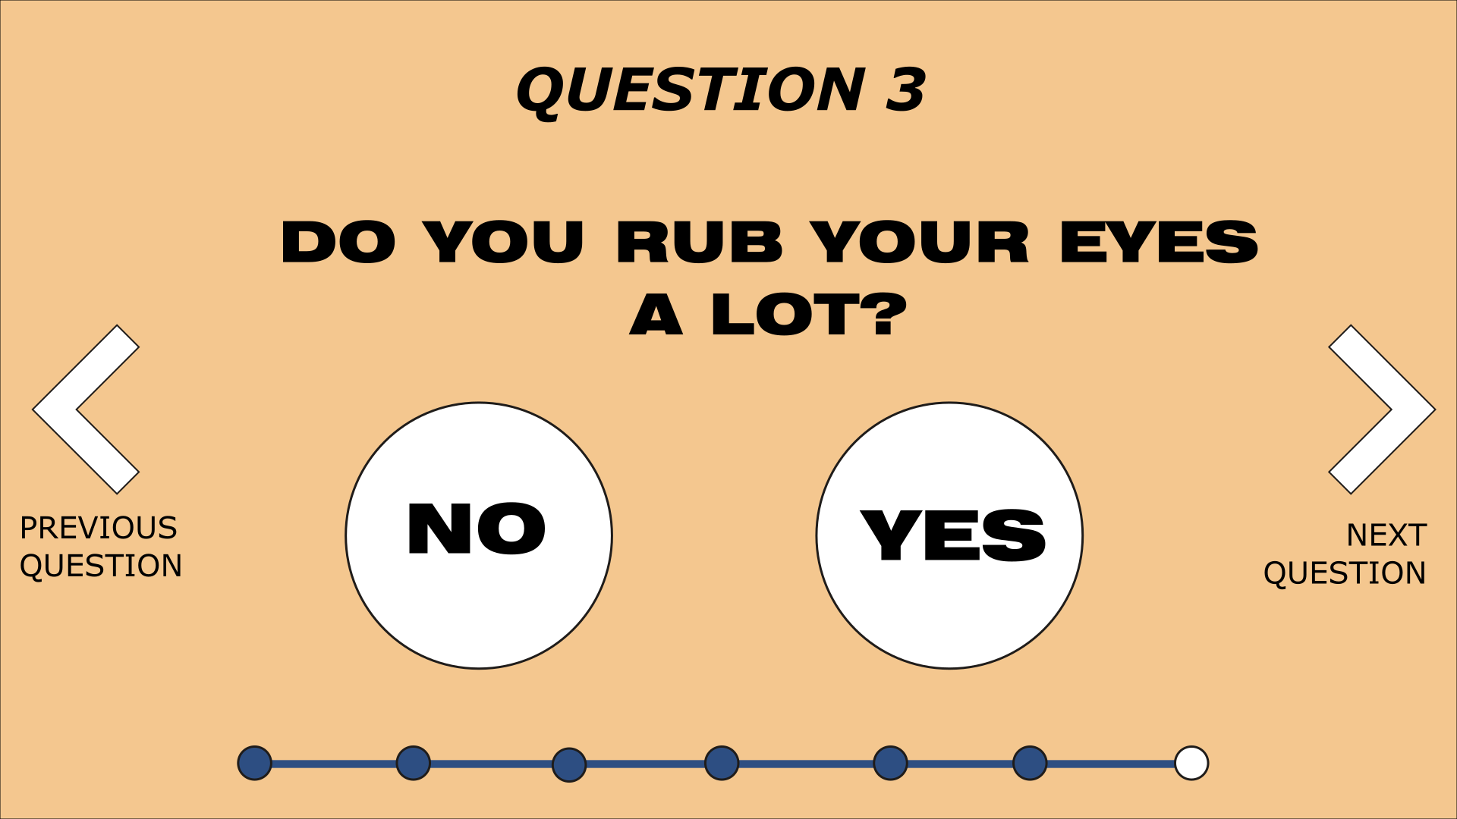

Slide 11
Open questions
What surprised me about the research is that excessive rubbing of the eye is considered to be a risk factor. This seems odd to me as my family and friends have admitted to doing this all the time with no vision consequences. I would like to know how the researchers documented this and found a connection.
I would also like to know why collagen cross linking in the only “solution” for Keratoconus and that there seems to be no cure for it. What is the biggest challenge regarding a cure for the disease? Would finding the cause/causes help narrow it down?

Slide 12
Works Cited
“What Causes KC.” NKCF.org, 14 June 2024, nkcf.org/what-causes-kc.
Nkcf. “Higher Than Expected - Rate of Pediatric Keratoconus in U.S.” NKCF.org, 12 July 2024, nkcf.org/higher-than-expected-rate-of-pediatric-keratoconus-in-u-s.

